Slide 1
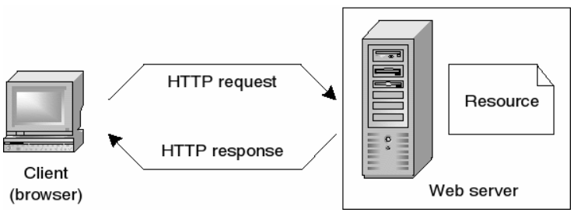
How does the web work?
Web pages are stored on web servers located around the globe.
Entering the Uniform Resource Locator or URL of a web page in the web browser or clicking a link sends a request to the server that hosts the page.
Web servers and web browsers communicate via HTTP.
The server transmits the web page data to client computer
HTTP ensures that all parts of the web page are delivered.
Web browser decides how these items are displayed.

Slide 2
How to Become a Web Developer
Five steps to become a Web Developer
Learn web development fundamentals, including an understanding of HTML (Hypertext Markup Language), CSS (Cascading Style Sheets), and JavaScript.
Choose a development specialization : All Web Developers are categorized into three main types: Front-End Developer, Back-End Developer, Full-Stack Developer.
Learn key programming languages for web development
Work on projects to develop Web Developer skills
Build a web development portfolio which includes a diverse selection of web development work.

Slide 3
Why did you choose to learn web development?
5 Reasons To Go Into Web Development
Web Developers Are In-Demand
Web Developers Earn a Great Living
Web Developers Have Diverse Opportunities
Web Developers Get to Be Creative
Web Developers Have Flexibility

